Slide 1







PARTNERSHIP
BUSINESS PRESENTATION:
Predictive Modeling for Optimal Vehicle Pricing- Data Analysis
CMPT-3830

Slide 2






MEET OUR TEAM - MLDRIVE
RENATA SACCON
GEETIKA LNU
BHARAT BAJAJ
MCLAREN PACKARD
IT PROGRAMMER
TEAM LEADER
DATA ANALYST
DATA ANALYST

Slide 3


MISSION
Build a regression model capable of predicting the optimal price range of a vehicle based on various characteristics, such as its year, model, and make.
PURPOSE
Empower Go Auto to optimize vehicle pricing strategies by leveraging data-driven insights, ensuring competitive pricing that maximizes sales and profitability while enhancing market positioning

Slide 4
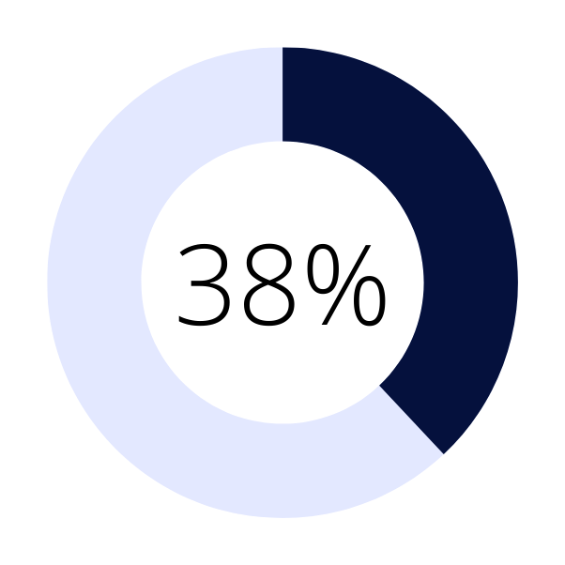
WHAT WE HAVE DONE SO FAR
 | Dataset Cleaning
 | Exploratory Data Analysis (EDA)
 | Feature Engineering: Created new features such as age of the vehicle (from year). Encoded categorical variables (e.g., make, model).
100%
THE PROJECT IS RUNNING
100%
100%

Slide 5
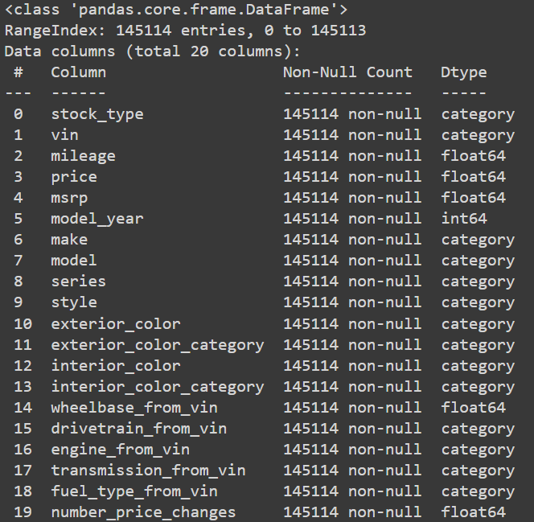
DATA CLEANING TECHNIQUES
Inspected the dataset using df.head(), df.unique(), and df.info().
Replaced missing values in numerical columns with the median.
Replaced missing values in categorical columns with the mode.
Removed duplicate rows with df.drop_duplicates(inplace=True).
Dropped unnecessary columns using df.drop(columns=column_to_remove).
Identified and handled outliers using the IQR method or with manual editing when IQR was not applicable.
df.info() on cleaned data

Slide 6
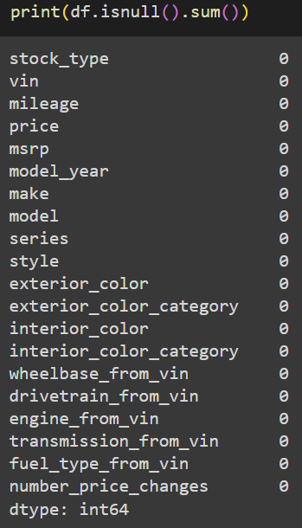
DATA CLEANING TECHNIQUES
Replaced zero values with NaN where zero is considered invalid.
Converted data types using astype().
Mapped transmission values with df.replace(): replaced 6 with M and 7 with A.
Performed a final data quality check using df.describe() and visualizations.
Number of null values left
in each column

Slide 7
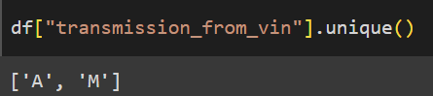
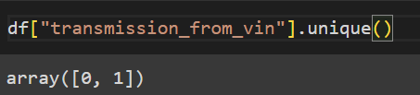
DATA ENCODING TECHNIQUES
Label Encoding: We used label encoding to convert categorical data into numerical values where applicable. For example, in cases where there were only two categories (e.g., Stock Type), we encoded 'used' as 0 and 'new' as 1.
One-Hot Encoding: This method was applied to handle categorical variables with more than two categories. One-hot encoding creates a binary column for each category, ensuring no numerical relationships are implied between different categories.
transmission_from_vin values before
label encoding
transmission_from_vin values after
label encoding

Slide 8
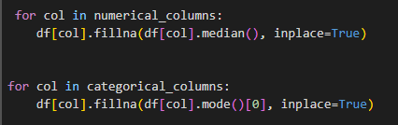
HANDLING MISSING VALUES:
For numerical columns with missing values, we replaced them using median.
For categorical columns with missing values, we replaced them using mode.
Your Code for filling in missing values for the columns

Slide 9
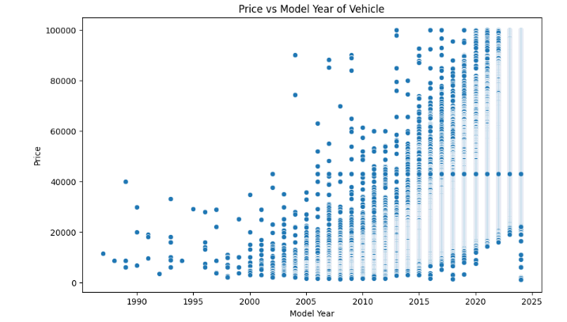
DATA INSIGHTS
PRICE VS. MODEL YEAR
Older vehicles (pre-2000) show a wide range of prices, but after around 2010, there is a more consistent trend of increasing prices. This suggests that newer models, particularly post-2015, have more stable pricing.
This reflects the typical market trend where newer models are more expensive.

Slide 10
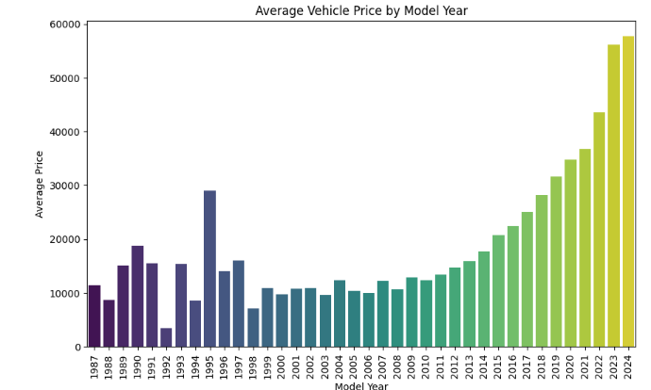
DATA INSIGHTS
AVERAGE VEHICLE PRICE BY MODEL YEAR
Older vehicles, especially those from the 1990s and early 2000s, have relatively lower average prices, typically under $20,000.
The data reveals models from the 1990s and earlier, which still maintain high prices. These might represent collector’s cars or models in excellent condition

Slide 11
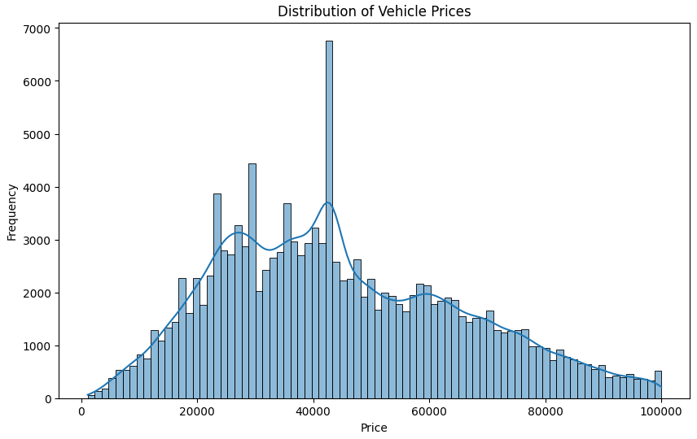
DATA INSIGHTS
DISTRIBUTION OF VEHICLES PRICES
The large peak around $40,000 may suggest that many customers are purchasing mid-range cars, which could reflect market trends such as a preference for reliable vehicles at moderate prices.
While fewer vehicles are priced in the luxury range, there is still a notable market for premium cars.

Slide 12
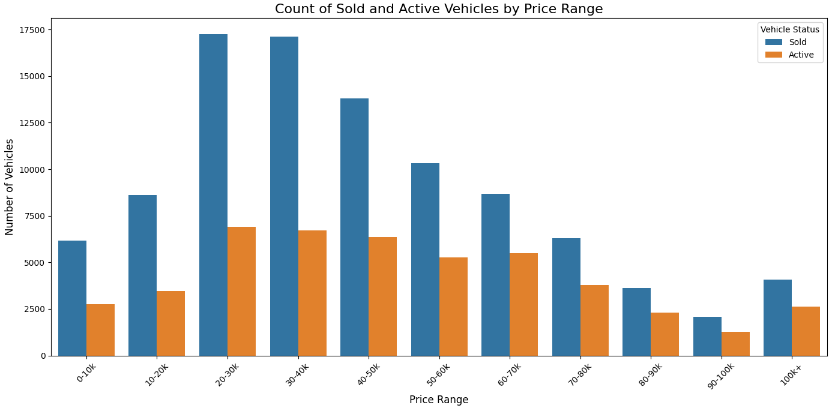
DATA INSIGHTS
COUNT OF SOLD AND ACTIVE VEHICLES BY PRICE RANGE
THE DATA SUGGESTS A "SWEET SPOT" IN THE $20K-$40K RANGE, WHERE THERE IS A BALANCE OF HIGH SUPPLY (ACTIVE LISTINGS) AND HIGH DEMAND (SOLD VEHICLES). THIS COULD BE THE IDEAL RANGE FOR BOTH SELLERS LOOKING TO MOVE INVENTORY QUICKLY AND BUYERS SEEKING THE BEST DEALS.

Slide 13
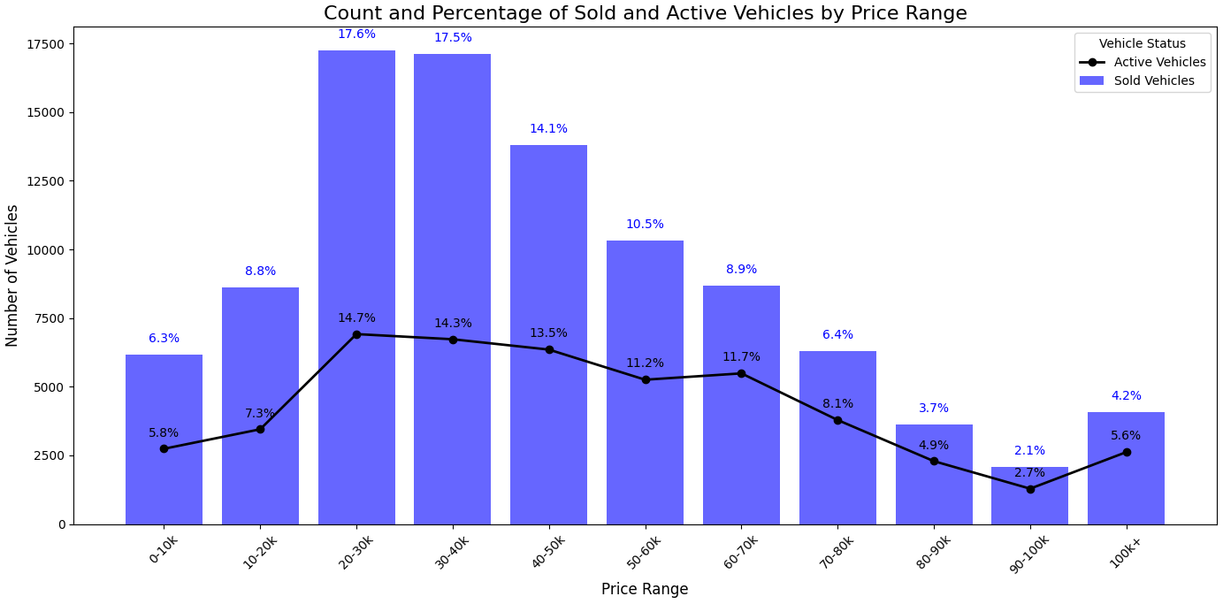
DATA INSIGHTS
COUNT OF SOLD AND ACTIVE VEHICLES BY PRICE RANGE
THIS GAP IS MOST NOTICEABLE IN THE 20-30K AND 30-40K RANGES, WHERE DEMAND IS HIGHEST, INDICATING THAT THE VEHICLES ARE MOVING RELATIVELY QUICKLY IN THESE CATEGORIES.
Potential overstock for high-range prices.

Slide 14
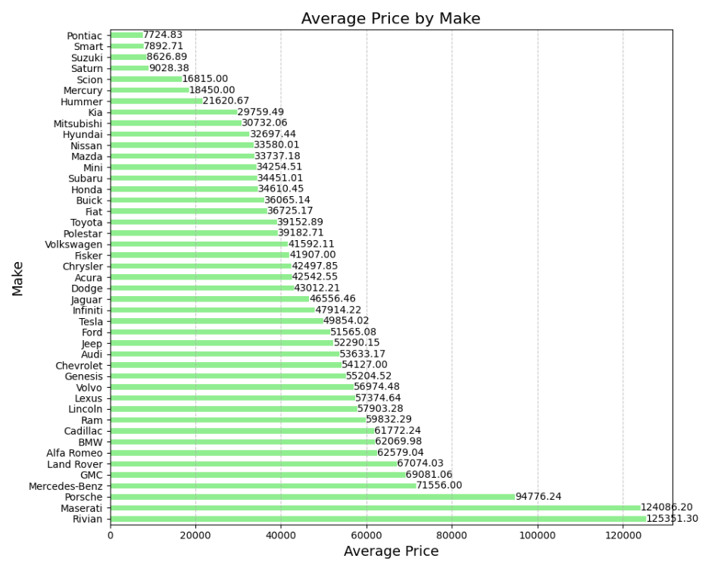
DATA INSIGHTS
AVERAGE PRICE BY MAKE
Rivian has the highest average price, significantly above other luxury brands like Mercedes-Benz and Maserati, despite being a relatively new player in the market.
Despite being discontinued for some time, Hummer still shows a relatively high average price.
Kia, traditionally seen as a budget brand, has a higher-than-expected average price, reflecting its move into the mid-to-upper range market.

Slide 15
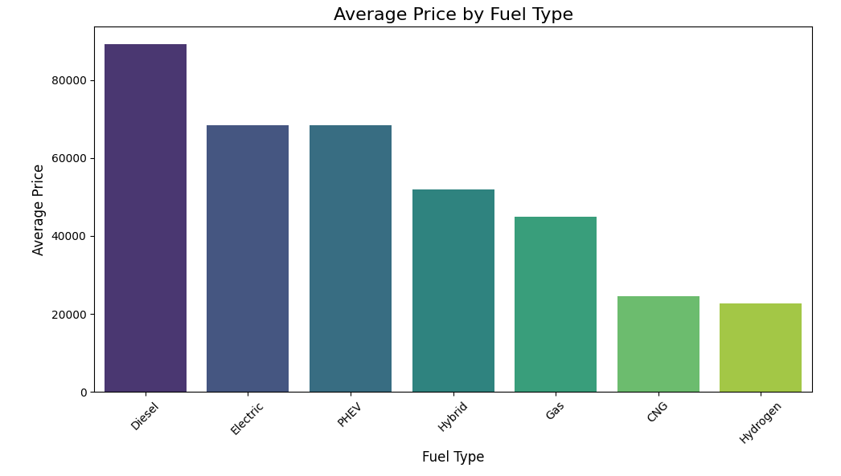
DATA INSIGHTS
AVERAGE PRICE BY FUEL
VEHICLES WITH DIESEL APPEAR TO HAVE A SIGNIFICANTLY HIGHER AVERAGE PRICE WHEN COMPARED TO OTHER FUEL TYPES.
Vehicles with hydrogen as their fuel appear to have the lowest average price at 22661, which reflects the low amount of hydrogen vehicles sold per year worldwide.

Slide 16
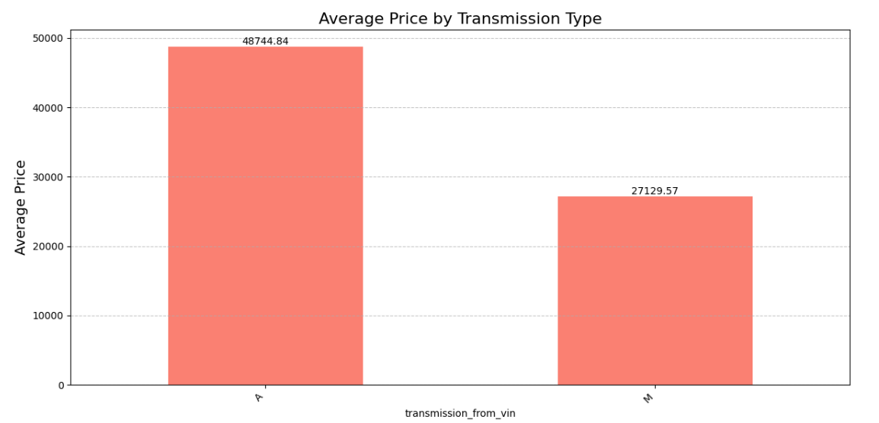
DATA INSIGHTS
AVERAGE PRICE BY TRANSMISSION TYPE
Automatic Transmission Dominates Higher Price Brackets.
While fewer vehicles are priced in the luxury range, there is still a notable market for premium cars.
Despite the lower average price, manual transmission vehicles may cater to a niche market, particularly among driving enthusiasts or those looking for cheaper options

Slide 17
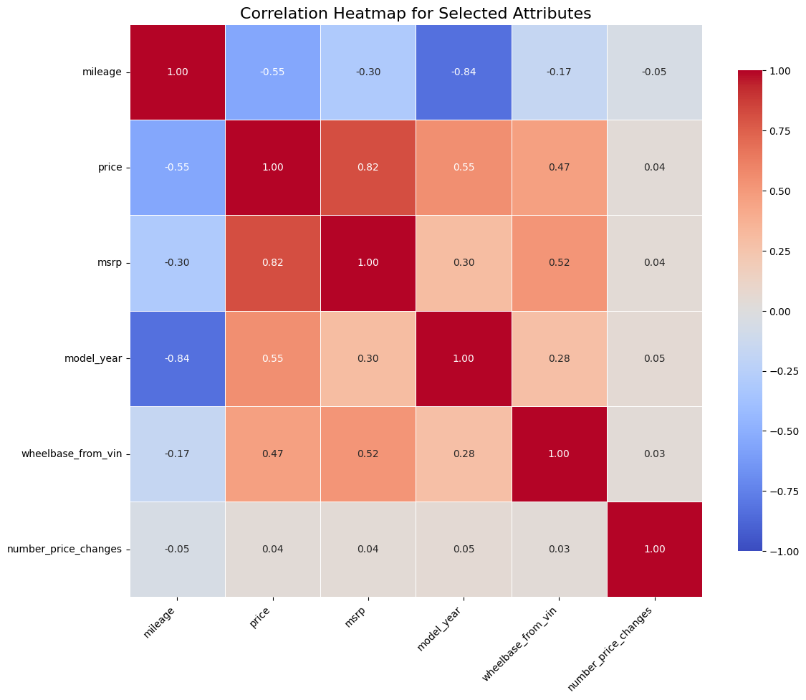
DATA INSIGHTS
Correlation heatmap
Mileage and Model Year Show Strong Negative Correlation (-0.84): As expected, newer vehicles tend to have lower mileage. This strong inverse relationship highlights how mileage is a good indicator of a vehicle's age.
Price and MSRP Have a Strong Positive Correlation (0.82): retail price (MSRP) suggests that vehicles generally sell close to their recommended retail price, with some variance. This confirms that MSRP can be a good predictor of the price.
Model Year Positively Correlates with Price (0.55): Newer model years tend to have higher prices, indicating that customers are willing to pay more for newer vehicles, which often come with advanced features and better technology, making them more valuable in the market.

Slide 18
NEXT STEPS
 | Build the Model: Test and refine the model’s performance. Validate using unseen data to ensure reliability.
 | Visualization and Insights: Present pricing predictions through graphs and charts. Make recommendations on pricing strategies.
 | Final Presentation Complete the final model and dashboard.
THE PROJECT IS RUNNING
In Progress
In Progress
In Progress

Slide 19
THANK YOU

